Slide 1
Create Successful Financial Literacy on Campus
Presented by:
Pat Robles-Friebert, Inceptia
Javier Labrador, ECMC
Lynne Garcia, Corinthian Colleges

Slide 2
CLFE Mission
As a diverse coalition of industry participants, CLFE shall engage in activities that improve and preserve the quality and integrity of education financing products and services delivered to California students, parents and schools.

Slide 3
2013 CLFE Member Organizations
All Management Corp
Brazos
Citizens Bank/Charter One
Discover Student Loans
ECMC
ELM Resources
First Marblehead
Great Lakes
iGrad
Inceptia
Nelnet
Sallie Mae
Simple Tuition
Social Finance
TG
USA Funds
Well Fargo

Slide 4
What is financial literacy?
Aptitude for understanding finance
Ability to make informed, effective decisions about finances
Knowledge of personal finances
Budgeting ▪ Banking basics
Managing credit cards ▪ Student loan
Understanding a paycheck

Slide 5
Which financial education delivery method works (would work) best
on your campus?

Slide 6
Which financial education delivery method works (would work) best on your campus?
Website Links
Email/E-Newsletters
Group Workshops
For-credit courses
One-on-one Sessions
Online Education/Gaming
Other

Slide 7
Making the Case – Rise in 3-Year Cohort Default Rates
Source: Department of Education official cohort default rates

Slide 8
Making the Case – Lack of Financial Skills 2010 State-by-State Financial Capability Survey
Source: 2010 State-by-State Financial Capability Survey conducted by FINRA Investor Education Foundation

Slide 9
Making the Case – Legislative Environment
Changes to Cohort Default Rates (CDR)
Initiatives by Consumer Financial Protection Bureau (CFPB)

Slide 10
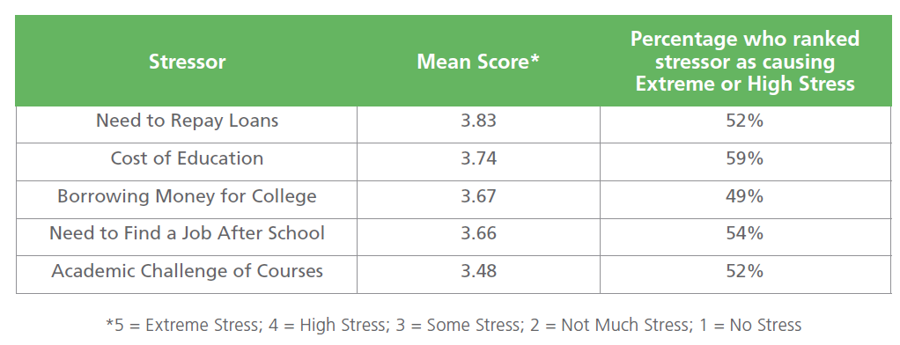
Making the Case – Stress and Money
Source: 2012 Inceptia Research Brief: Financial Stress: An Everyday Reality for College Students

Slide 11
Making the Case – Financial Knowledge
Source: 2012 Inceptia Financial Capability Survey

Slide 12
Making the Case – Students Want Help
84% of college students want more information on financial education topics.
24% of college students say they are well prepared for the financial challenges that await them after graduation
Source: 2009 Sallie Mae survey
Source: 2007 Hartford Financial Services

Slide 13
Identify Your Students’ Needs
What is the most important
personal finance topic
for students to understand?

Slide 14
Identify Your Students’ Needs
Survey students
Topics
Delivery methods
Review results
Draft a curriculum
Survey Topics
Banking Basics
Buying a home or car
Credit reports and scores
Debt and Borrowing
Financial Goal-Setting
Health and life insurance
Identity theft
Investment basics
Making a budget
Making major purchases
Paycheck and taxes
Paying for College
Rebuilding credit
Renter’s and auto insurance
Setting and saving for goals
Understanding credit

Slide 15
Create a Success Team
Look at your organization chart to identify potential departments to partner with
Create a proposal
Define the purpose
Identify benefits to school and students
Propose delivery methods and potential content
Note success measurements
Outline costs, resources, and potential personnel
Confirm buy-in

Slide 16
Career School Organizational Chart

Slide 17
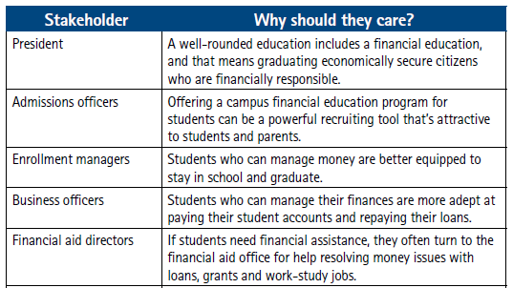
Why They’ll Buy In
Full chart available at:
http://apps.Inceptia.org/PDF/Inceptia_FinancialCapability_Whitepaper.pdf

Slide 18
Implementing Financial Literacy on Campus

Slide 19
Planning Timeline

Slide 20
The Proposal
Describe the event
Incorporate the four P’s
Product – what is it?
Price – is there a cost?
Placement – where/how would it take place?
Promotion – how will the message be communicated
Include a motivator
Include a benefit statement for both school and students
End with a call to action
Notes:
____________________________________________________________________
____________________________________________________________________
____________________________________________________________________
____________________________________________________________________
____________________________________________________________________
____________________________________________________________________
____________________________________________________________________
____________________________________________________________________
____________________________________________________________________

Slide 21
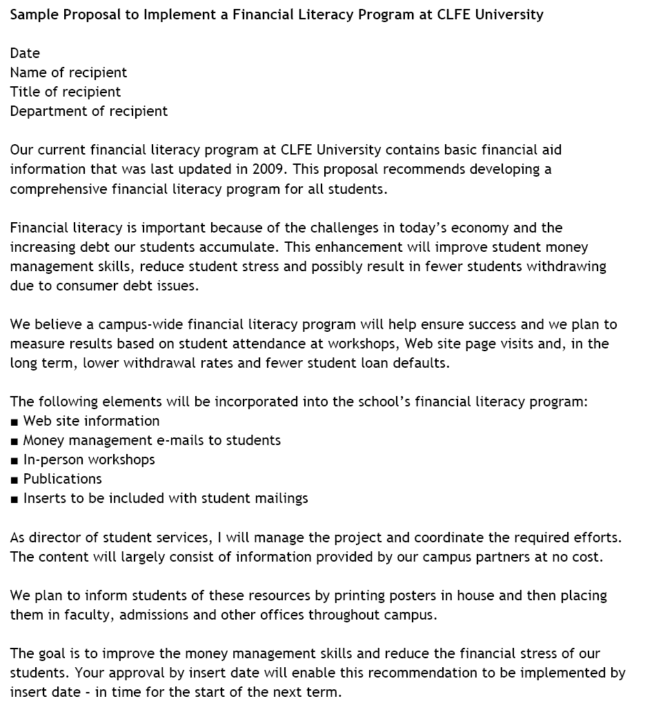
The Proposal
Describe the event
Motivator
Benefits
Product
Placement
Price
Promotion
Call to action
Notes:
____________________________________________________________________
____________________________________________________________________
____________________________________________________________________
____________________________________________________________________
____________________________________________________________________
____________________________________________________________________
____________________________________________________________________
____________________________________________________________________
____________________________________________________________________

Slide 22
What is the best way to promote financial literacy offerings to your students?

Slide 23
What is the best way to promote financial literacy offerings to your students?
Social Media (Facebook, Twitter, Pinterest, Instagram, etc)
Contests/Sweepstakes
Email/E-Newsletters
Flyers/Posters
Word-of-Mouth
Other

Slide 24
Marketing - Getting Students to Attend
What is the topic/name of the workshop?
What time does the workshop begin and end?
Where is the workshop?
Which methods will be used to promote the workshop?
Social media, contests/sweepstakes, email/e-newsletters, word-of-mouth, etc.
How will the attendee benefit?

Slide 25
Marketing and Promotion
Utilize social media
Build in to existing services (FYE, Greek Life, Housing, etc.)
Educate your colleagues
Word-of-mouth

Slide 26
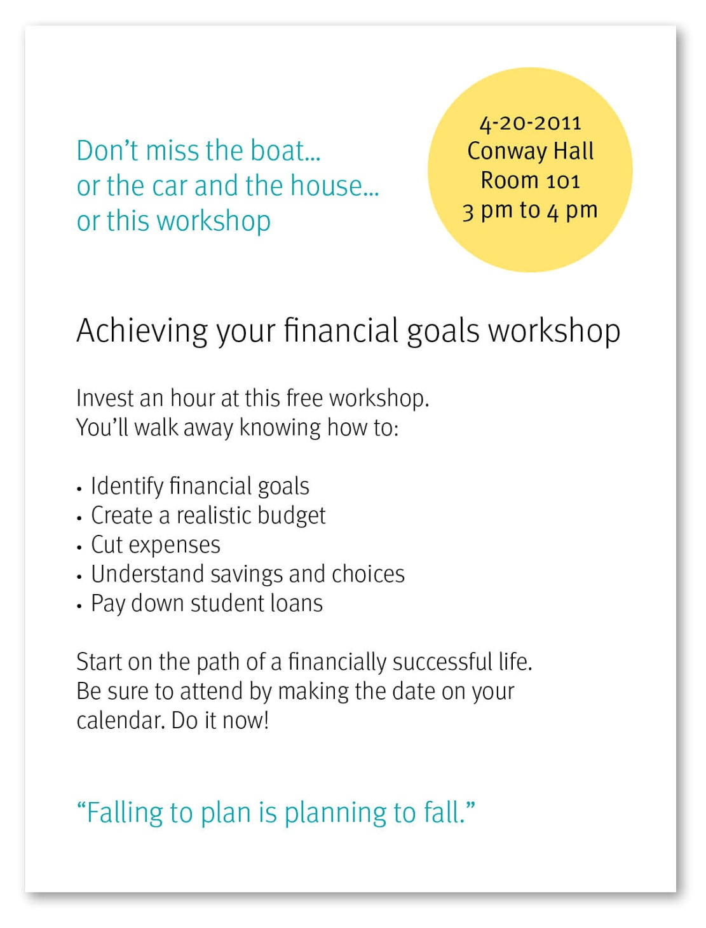
Find the message
Price
Product
Placement
Promotion
Motivator to act
Benefit statement
Call to action
“Failing to plan is planning to fail.”

Slide 27
Example Flyer

Slide 28
Student Participation
Innovators – Seek new opportunities and ideas
Early adopters – Grasp and apply some ideas
Early majority – Gathering ideas
Late majority – Aware of ideas
Laggards – Unconcerned

Slide 29
Paying for a Financial Education Program
External
Internal dollars
In-kind
Leverage existing resources
Certify your staff
Students
Free resources

Slide 30
Case Study: Corinthian Colleges, Inc.
A Campus Student Loan Specialist at Every Everest and WyoTech campus: Creating and Fostering Rapport
Mandatory Financial Literacy
Mandatory In-Person Exit Counseling for Graduates
On-going workshops and outreach events

Slide 31
Case Study: Corinthian Colleges, Inc.
Partnerships
Across campus
Interdepartmental Collaborations
Outside organizations
Banks
Credit Unions
Community organizations

Slide 32
Free Resources
National Endowment for Financial Education’s Cash Course (cashcourse.org)
VISA’s Financial Football and Soccer (practicalmoneyskills.com)
Financial Literacy and Education Commission’s My Money (mymoney.gov)
Inceptia Institute (institute.inceptia.org)
ECMC’s Financial Awareness Basics (ecmc.org/overview/financial-awareness-basics.html)
Great Lakes Financial IQ (mygreatlakes.org)
Simple Tuition’s Payback Smarter (paybacksmarter.com)

Slide 33
Training Created Through Collaboration of CLFE Members and Presented by:
 | Pat Robles-Friebert patf@inceptia.org
 | Javier Labrador jlabrador@ecmc.org
 | Lynne Garcia lyngarcia@cci.edu
Special thanks to the presenters, along with the Inceptia and ECMC internal teams, for their contributions to content!

